Slide 1
Improving RF-Based Device-Free Passive Localization In Cluttered Indoor Environments Through Probabilistic Classification Methods
Rutgers University
Chenren Xu
Joint work with
Bernhard Firner, Yanyong Zhang
Richard Howard, Jun Li, Xiaodong Lin

Slide 2
Passive Localization
Motivation
Indoor challenge
Proposed solution
Experimental methodology
Performance evaluation
Conclusion and future work

Slide 3
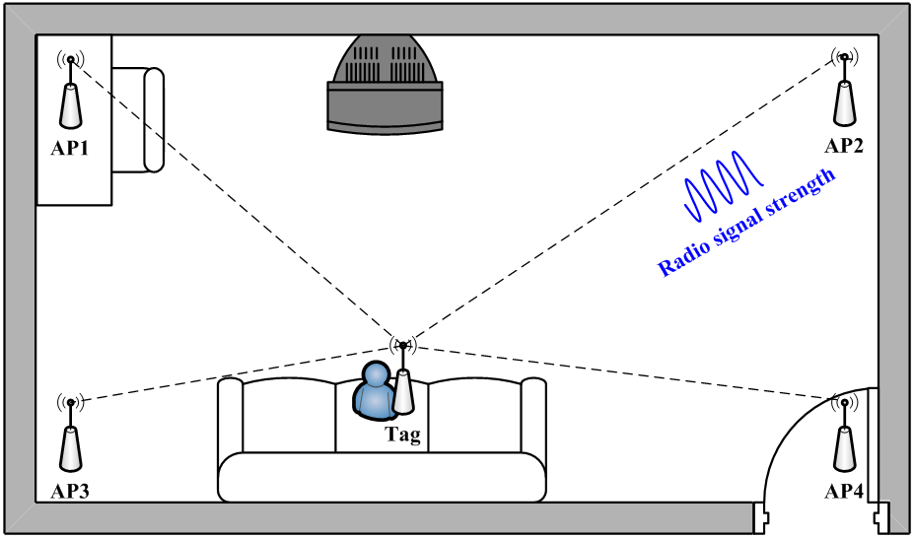
RF-Based Localization
Active Localization

Slide 4
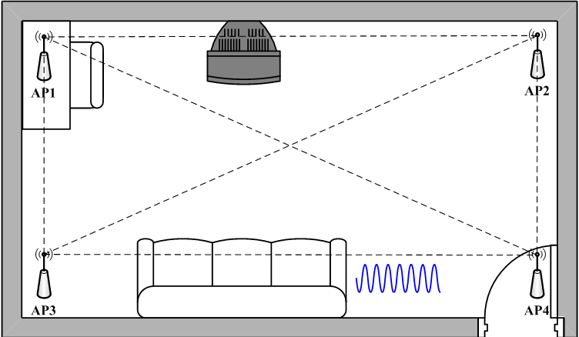
RF-Based Localization

Slide 5
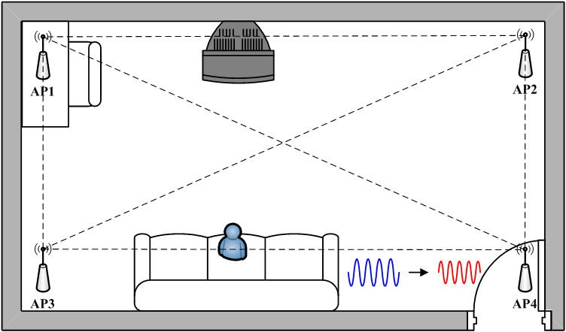
RF-Based Localization
Passive Localization

Slide 6
Passive Localization
Motivation
Indoor challenge
Proposed solution
Experimental methodology
Performance evaluation
Conclusion and future work

Slide 7
Why Passive Localization?
Monitor indoor human mobility
Elder/health care

Slide 8
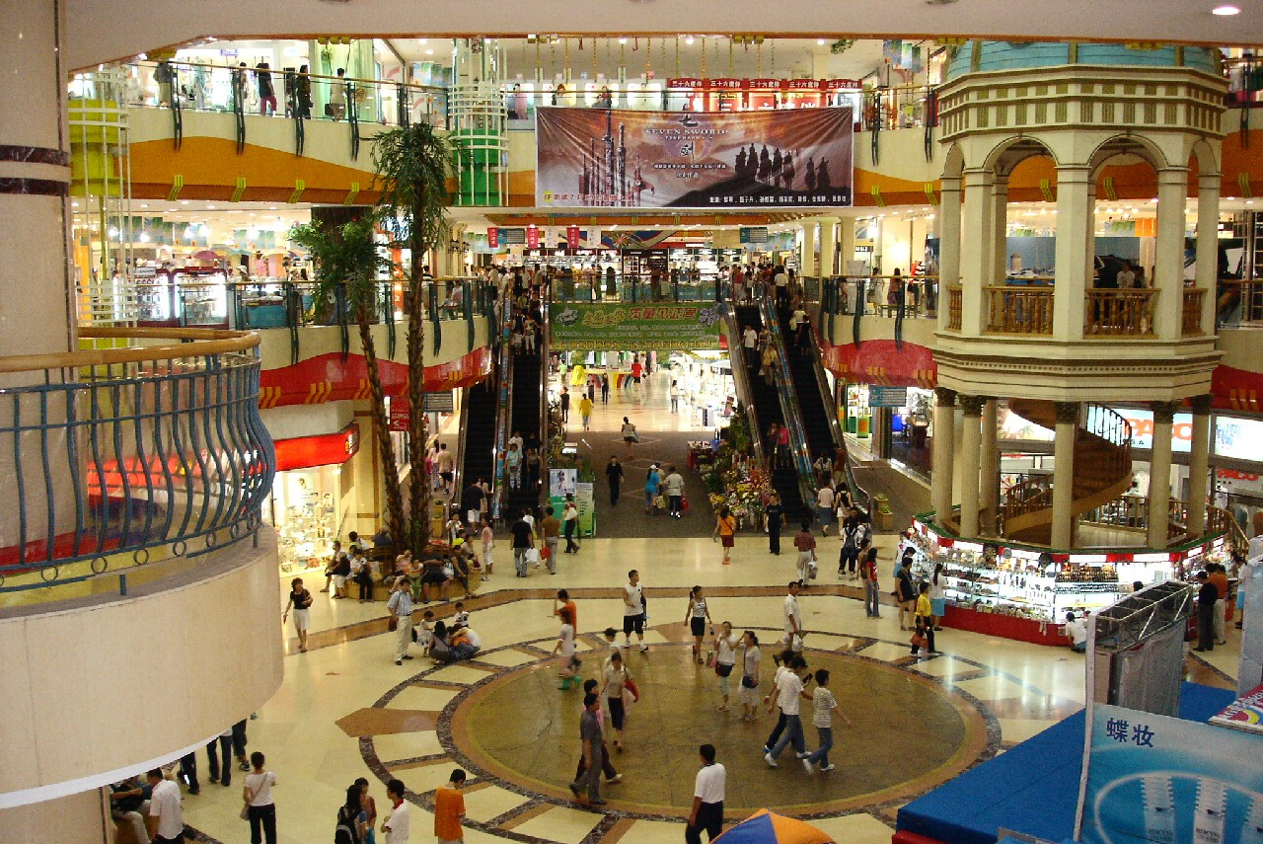
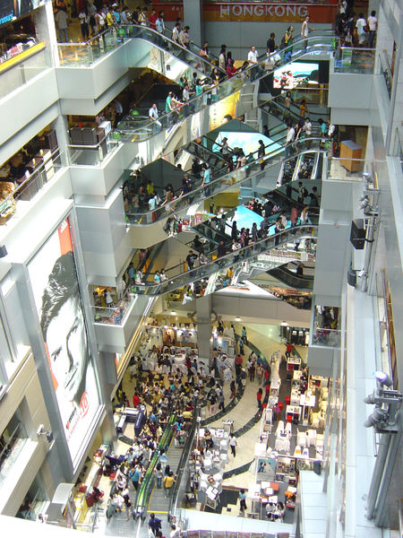
Why Passive Localization?
Monitor indoor human mobility
Detect traffic flow

Slide 9
Why Passive Localization?
Monitor indoor human mobility
Health/elder care, safety
Detect traffic flow
Provides privacy protection
No identification
Use existing wireless infrastructure

Slide 10
Passive Localization
Motivation
Indoor challenge
Proposed solution
Experimental methodology
Performance evaluation
Conclusion and future work

Slide 11
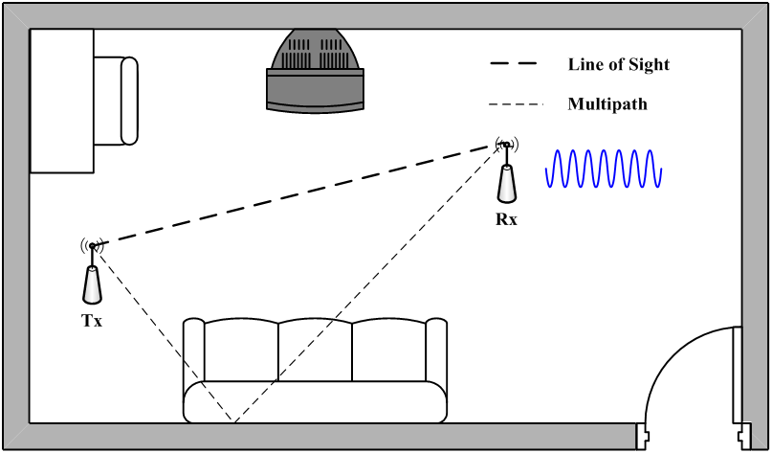
Multipath Effect

Slide 12
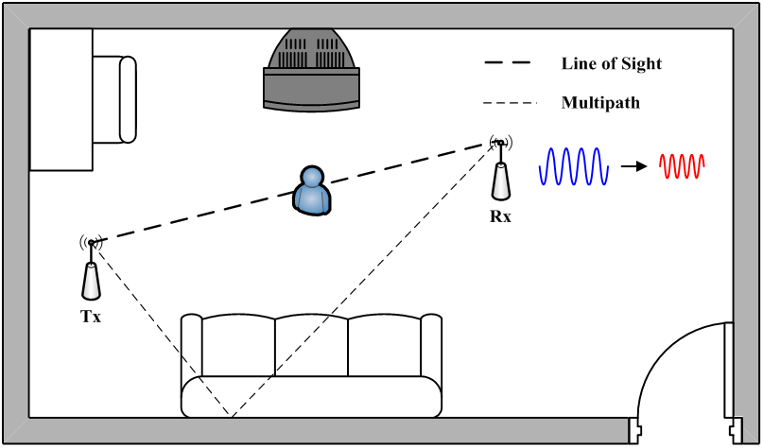
Multipath Effect

Slide 13
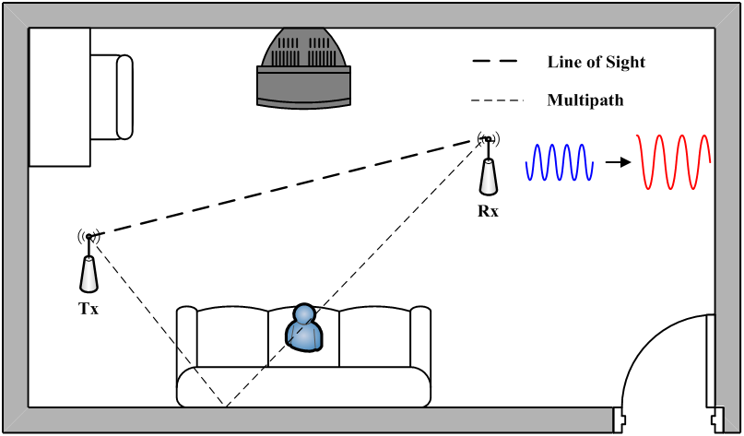
Multipath Effect

Slide 14
Cluttered Indoor Scenario

Slide 15
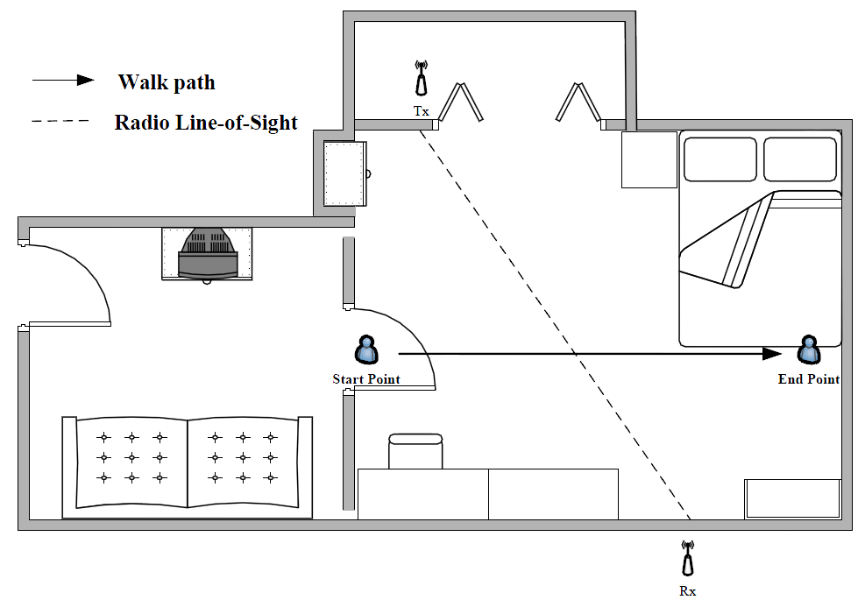
Cluttered Indoor Scenario
A user steps across one Line-of-Sight

Slide 16
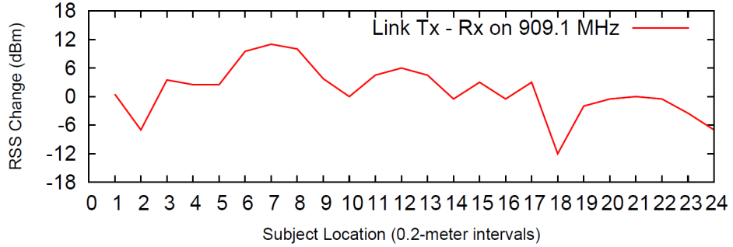
Cluttered Indoor Scenario
A user steps across one Line-of-Sight
RSS fluctuates in a unpredictable fashion

Slide 17
Cluttered Indoor Scenario
The RSS change can either go up to 12 dBm

Slide 18
Cluttered Indoor Scenario
Or go down to -12 dBm

Slide 19
Cluttered Indoor Scenario
These two peak points can have 24 dB difference in energy within only 2 meters.

Slide 20
Cluttered Indoor Scenario
Deep fade
We also observe that these two points within 0.2 m can have 15 dB difference.

Slide 21
Cluttered Indoor Scenario

Slide 22
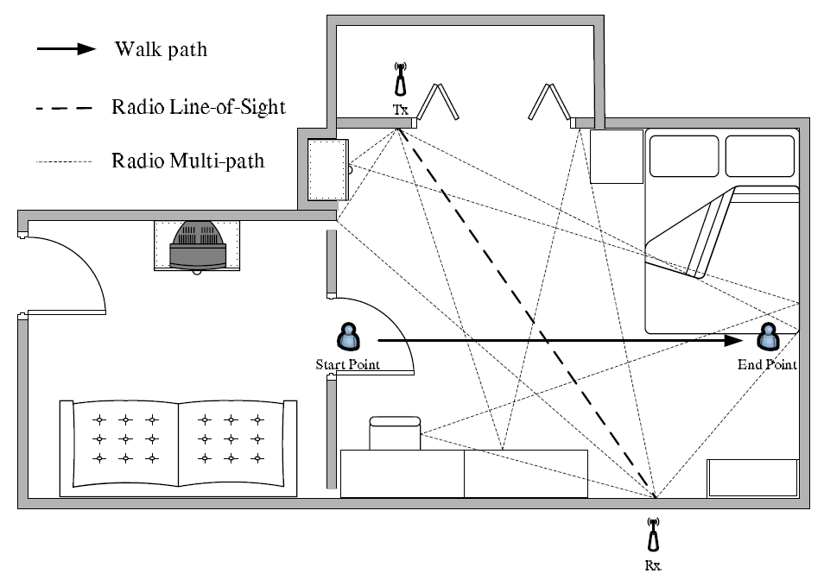
Cluttered Indoor Scenario

Slide 23
Cluttered Indoor Scenario

Slide 24
Passive Localization
Motivation
Indoor challenge
Proposed solution
Experimental methodology
Performance evaluation
Conclusion and future work

Slide 25
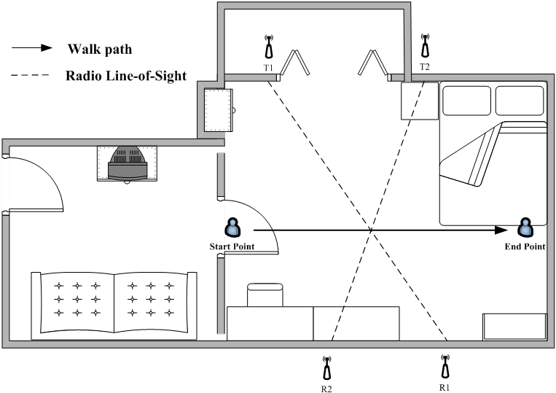
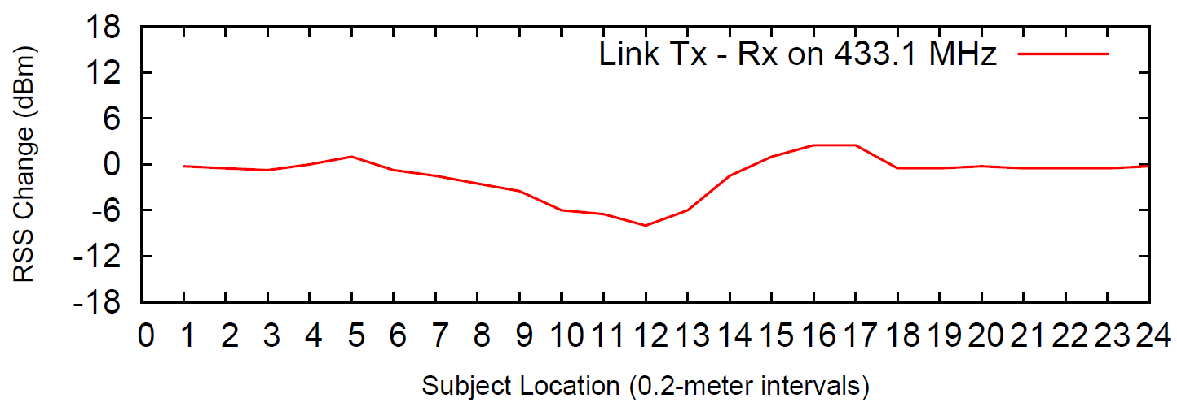
Proposed Solution
High dimensional space
Measure radio signal strength (RSS) changes in multiple transmitter and receiver links.
Link T1 – R1
Link T2 – R2

Slide 26
Proposed Solution
High dimensional space
Cell-based localization
Flexible precision
Classification approach

Slide 27
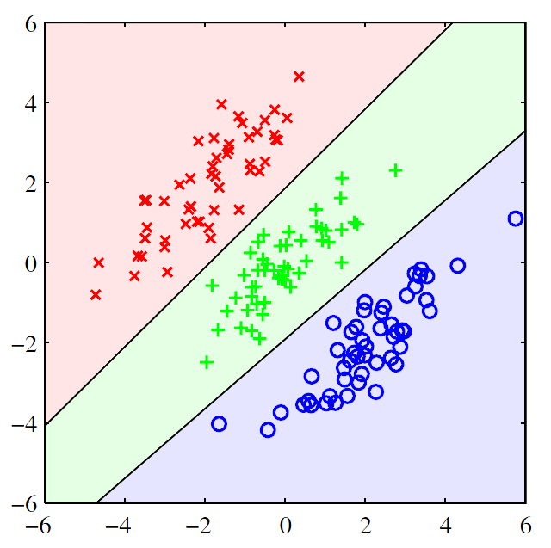
Linear Discriminant Analysis
RSS measurements with user’s presence in each cell is treated as a class k
Each class k is Multivariate Gaussian with common covariance
Linear discriminant function:
Link 2 RSS (dBm)
k = 1
k = 2
k = 3
Link 1 RSS (dBm)

Slide 28
Proposed Solution
High dimensional space
Cell-based localization
Lower radio frequency
Smooth the spatial variation

Slide 29
Frequency Impact
RSS changes smoother on 433.1 MHz than on 909.1 MHz

Slide 30
Frequency Impact
Less deep fading points!

Slide 31
Proposed Solution
High dimensional space
Find features with fewer deep fading points
Cell-based localization
Average the deep fading effect
Lower radio frequency
Reduce the deep fading points
Mitigate the error caused by the
multipath effect!

Slide 32
Passive Localization
Motivation
Indoor challenge
Proposed solution
Experimental methodology
Performance evaluation
Conclusion and future work

Slide 33
Experimental Deployment
Total Size:
5 × 8 m

Slide 34
Experimental Deployment

Slide 35
System Parameters
Parameter | Default value | Meaning
K | 32 | Number of cells
P | 64 | Number of pair-wise radio links
Ntrn | 100 | Number of training data per cell
Ntst | 100 | Number of testing data per cell

Slide 36
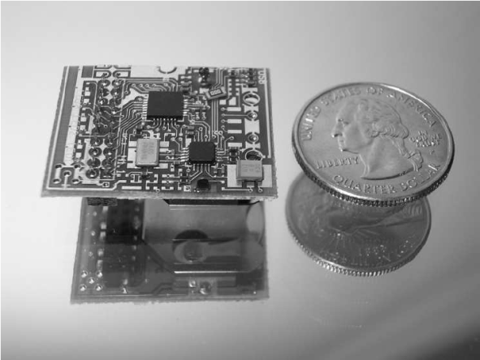
System Description
Hardware: PIP tag
Microprocessor: C8051F321
Radio chip: CC1100
Power: Lithium coin cell battery (~1 year)
Protocol: Unidirectional heartbeat (Uni-HB)
Packet size: 10 bytes
Beacon interval: 100 millisecond

Slide 37
Training Methodology
Case A: stand still at the each cell center
Measurement only involves center of the cell
Ignore the deep fade points
Case B: random walk within each cell
Measurement includes all the space
Average the multi-path effects
Training only takes 15 mins!

Slide 38
Passive Localization
Motivation
Indoor challenge
Proposed solution
Experimental methodology
Performance evaluation
Conclusion and future work

Slide 39
Metrics
Cell estimation accuracy
The ratio of successful cell estimations with respect to the total number of estimations.
Average error distance
Average distance between the actual location and the estimated cell’s center.

Slide 40
Localization Accuracy
Cell estimation accuracy:
 | Stand still at each cell center | Random walk with in each cell
433.1 MHz | 90.1% | 97.2%
909.1 MHz | 82.9% | 93.8%
97.2 % cell estimation accuracy with 0.36 m average error distance

Slide 41
Reducing Training Dataset
Only 8 samples are good enough
8
100

Slide 42
Robust to Link Failure
5 transmitter +
3 receivers =
90% cell estimation accuracy

Slide 43
Long-term Stability

Slide 44
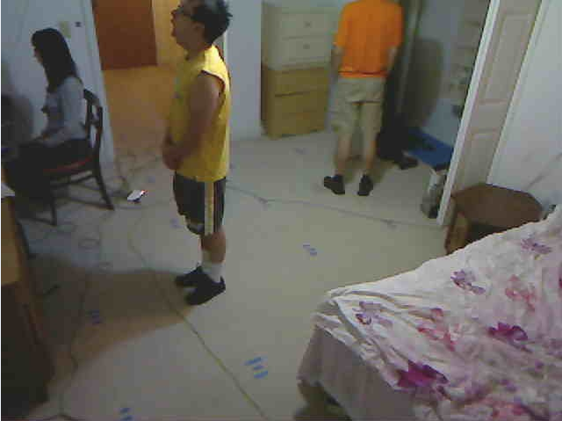
Multiple Subjects Localization

Slide 45
Larger Deployment
Total Size: 10 × 15 m Cell Size: 2 × 2 m
13 transmitters and 9 receivers

Slide 46
Larger Deployment
Cell estimation accuracy: 93.8%
Average error distance: 1.3 m

Slide 47
Passive Localization
Motivation
Indoor challenge
Proposed solution
Experimental methodology
Performance evaluation
Conclusion and future work

Slide 48
Conclusion and Future Work
Conclusion
We propose a general probabilistic classification framework to solve the passive localization problem with:
High accuracy, low cost, robust and stable
Multiple subjects tracking generalization
Future work
Improving multiple people tracking
Passively detect the number of people

Slide 49
Q & A
Thank you

