Slide 1
Demo: Lost and Found! Associating Target Persons in Camera Surveillance Footage with Smartphone Identifiers
Hansi Liu, Abrar Alali, Mohamed Ibrahim, Hongyu Li, Marco Gruteser, Shubham Jain, Kristin Dana, Ashwin Ashok, Bin Cheng, Hongsheng Lu

Slide 2
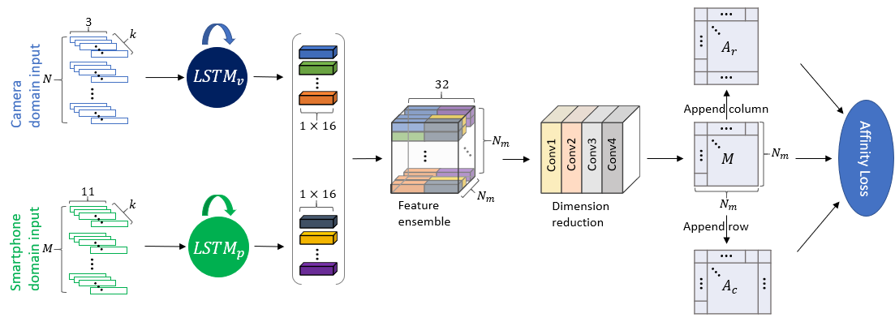
Video
Wireless Data
Tracker
Camera-Phone association
Sync
Camera Modality
Phone Modality
Bounding boxes
Depth
FTM
IMU
Face Recognition
Phone C
Phone A
Query ID ?
😟
 | 1 | 2 | 3 | 4 | 5 | Ø
A | 0 | 0 | 0 | 0 | 0 | 1
B | 0 | 0 | 0 | 0 | 0 | 1
C | 0 | 1 | 0 | 0 | 0 | 0
D | 0 | 0 | 1 | 0 | 0 | 0
E | 1 | 0 | 0 | 0 | 0 | 0
Ø | 0 | 0 | 0 | 0 | 0 | 0
Wireless Visual tagging
Low resolution
Occlusion
Challenging lighting conditions
Query ID ?
Phone B
Query ID ?
Notes:
In this work, we propose a method that leverages information from Wi-Fi FTM measurements and smartphone IMU motion sensor data to match detected participants in the camera view with their smartphone IDs.
We introduce a multi-modal affinity learning network that exploits spatial-temporal similarities between feature embeddings from camera and phone modalities. It learns a latent similarity metric and predicts an affinity matrix that consists of association probabilities for every camera-phone pair. By finding the highest probability in each column of the matrix, we are able to associate each bounding box to the corresponding smartphone ID.

Slide 3
Video
Wireless Data
Tracker
Camera-Phone association
Sync
Camera Modality
Phone Modality
Bounding boxes
Depth
FTM
IMU
Phone C
Phone A
 | 1 | 2 | 3 | 4 | 5 | Ø
A | 0 | 0 | 0 | 0 | 0 | 1
B | 0 | 0 | 0 | 0 | 0 | 1
C | 0 | 1 | 0 | 0 | 0 | 0
D | 0 | 0 | 1 | 0 | 0 | 0
E | 1 | 0 | 0 | 0 | 0 | 0
Ø | 0 | 0 | 0 | 0 | 0 | 0
Wireless Visual tagging
Phone B

Slide 4
Thank You
For more information, please refer to our paper:
Liu et al. “Demo: Lost and Found! Associating Target Persons in Camera Surveil-lance Footage with Smartphone Identifiers”

