Slide 1
FusionEye: Perception Sharing for Connected Vehicles and its Bandwidth-Accuracy Trade-offs
Hansi Liu*, Pengfei Ren†, Shubham Jain‡, Mohannad Murad†, Marco Gruteser*, Fan Bai†
*Rutgers University, †General Motors, ‡Old Dominion University
Notes:
Hello everyone, thanks for having me here.
My talk today is about sharing views for connected vehicle systems and exploring its accuracy and bandwidth trade-offs

Slide 2
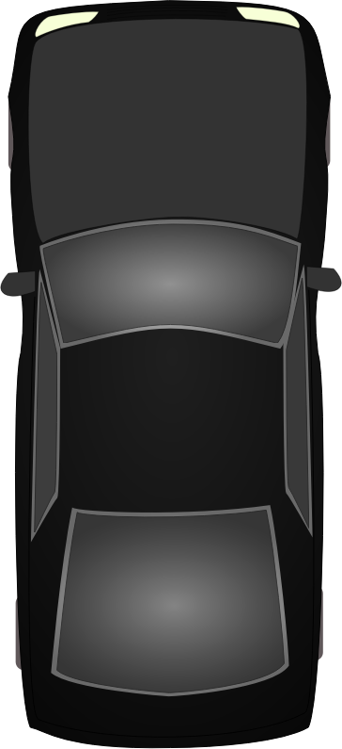
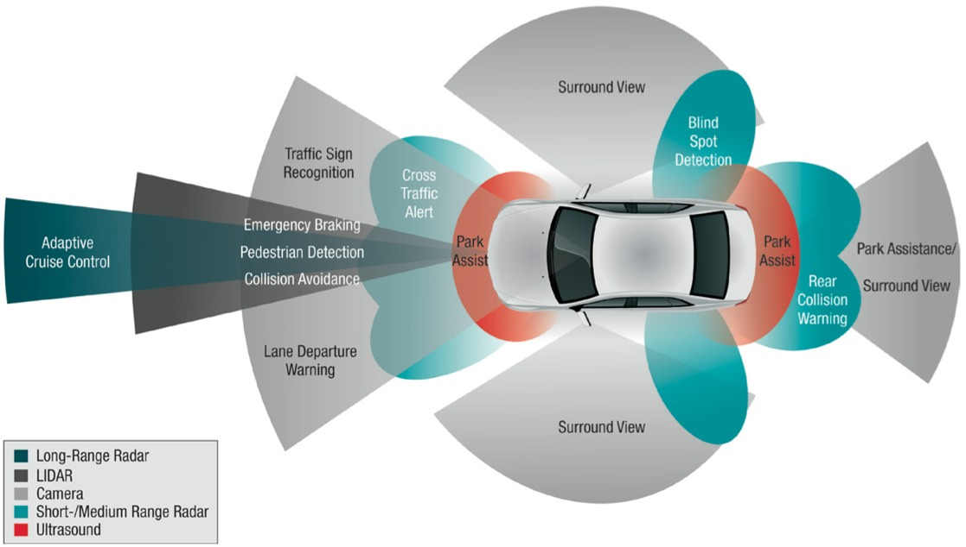
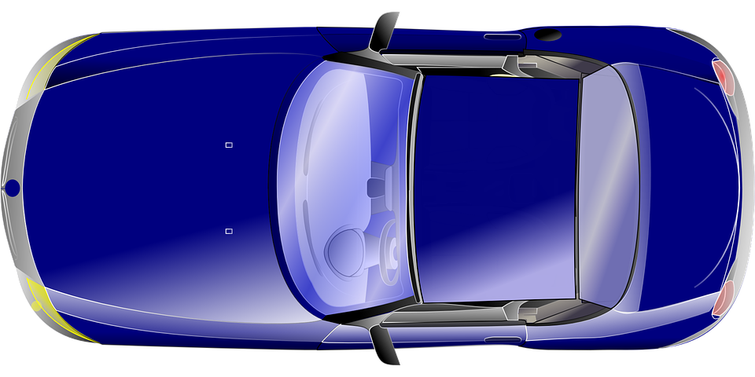
Motivation: limited sensing range
Bang
Cannot be seen by Blue due to blockage
Various sensors on a vehicle for surrounding awareness
Limited sensing range causes hazards or accidents
Sharing perception between vehicles can prevent such accidents
Notes:
These days, A smart vehicle is equipped with various sensors to be aware of the surroundings, (Only one sentence)
Although these sensors allow certain level of situation awareness, each individual vehicle’s sensing range is limited, which poses hazards on safety driving environments.
Animation example
How to prevent such hazards? –one solution is to share perceptions between vehicles

Slide 3
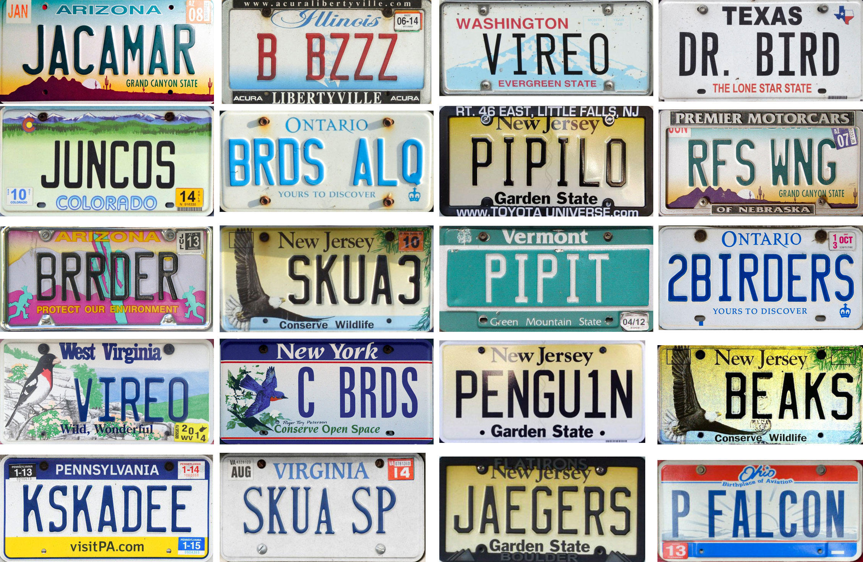
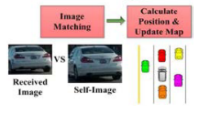
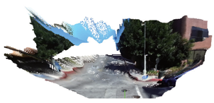
Existing connected vehicle sharing systems
DSRC Sharing
Each participating vehicle’s own information
GPS, velocity [1]
Unique IDs, (license plate numbers) [2]
Sensor sharing
Each participating vehicle’s own and surrounding information
Vehicles’ profile images
Dense point cloud [3]
[1] Fujii et al. “Cooperative Vehicle Positioning via V2V Communications and Onboard Sensors”
[2] Meng et al. “OmniView: A Mobile Collaborative System for Assisting Drivers with a Map of Surrounding Traffic”
[3] Qiu et al. “AVR: Augmented Vehicular Reality”
Notes:
Recently there are numbers of works that focus on sharing information for connected vehicle systems. (don’t say ”perception sharing”)
The main goal of these works is to share each participating vehicle’s information with each other so that everyone has a better understanding of the surrounding environment.
We categorize these works into two categories.
DSRC based sharing: in which only the vehicle’s own information is being shared
Sensor sharing: in this category, not only each vehicle’s own information, but also the surrounding information is being shared

Slide 4
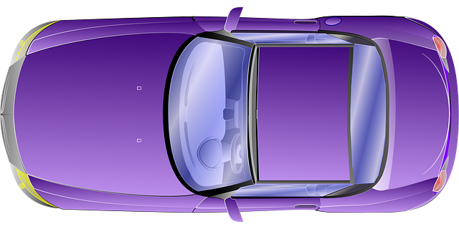
Share & Merge
Information sharing between two individual views
Merge: are these vehicles the same?
Accurate merging provides a merged “global” view
correct merging?
4/19
Notes:
In this work we are more interested in camera sensing and sharing, since camera is ubiquitous and usually don’t need a lot of special configurations.
The basic idea of sharing and merging is as follows:
(Show animation)
During the merging step it’s important to identify whether two vehicles are the same or not. This is usually an verification or association task.
After correct merging, a global view is construct and the field of view for each vehicle is expanded.

Slide 5
Efficient Sharing & Accurate Merging
Accurate Merging
Correct vehicle association between individual topologies
Efficient sharing
Low latency
Low drop rate
Small Bandwidth
What information should be shared for both accurate merging and efficient transmission?
Distance? Appearances? Combination?
Notes:
As we have mentioned in the previous slide, correct merging is critical and essential for constructing a correct global topology. So naturally, we care about this merging accuracy and we ask ourselves how can we ensure accurate merging?
Intuitively, the more information we share, the more accurate the merging decision will be. (we anticipate more information will be more helpful)
At the same time, we also wish to lower the transmission latency and drop rate, as well as save bandwidth while we are sharing these information. So we might not want share too much information which may be redundant.
Question: (show animation here)

Slide 6
System Overview
Explore the design space of perception sharing system
Features of the system
For side-by-side driving cases
Supports various feature representations
Proposed a bipartite merging algorithm
Supports various feature representations
Allows accuracy-bandwidth trade-off exploration
Achieves accurate and efficient merging
Perception Generation
View 1
View 2
Object detection
Object detection
Feature extraction
Feature Extraction
Perception Sharing
Topology Fusion
2
s1
2
s2
1
s3
1
1
s3
1
s4
s5
0
s6
0
0
s6
0
Notes:
In this work, we explore the design space of a perception sharing system by proposing a pipeline as shown here.
The system has three major components: Perception Generation, Perception Sharing and Topology Fusion.
In Perception Generation: we first detect the vehicles for individual views, and we extract various kinds of features for the detected vehicles.
Then in the perception sharing component we share these features via wireless network to allow these information to be merged and fused at one end, which comes to the third component: Topology fusion.
In the topology fusion component, we proposed a bipartite merging algorithm that associate vehicles from two views.
One advantage of this bipartite merging algorithm is that it supports various feature representations to be the edge scores here, which represents the similarity between two vehicles. And this score can also be computed by different combinations of features.
Another advantage of this bipartite merging algorithm is that it allows us to explore the accuracy-bandwidth trade-off, to find out what information shall be shared to achieve accurate and efficient merging.

Slide 7
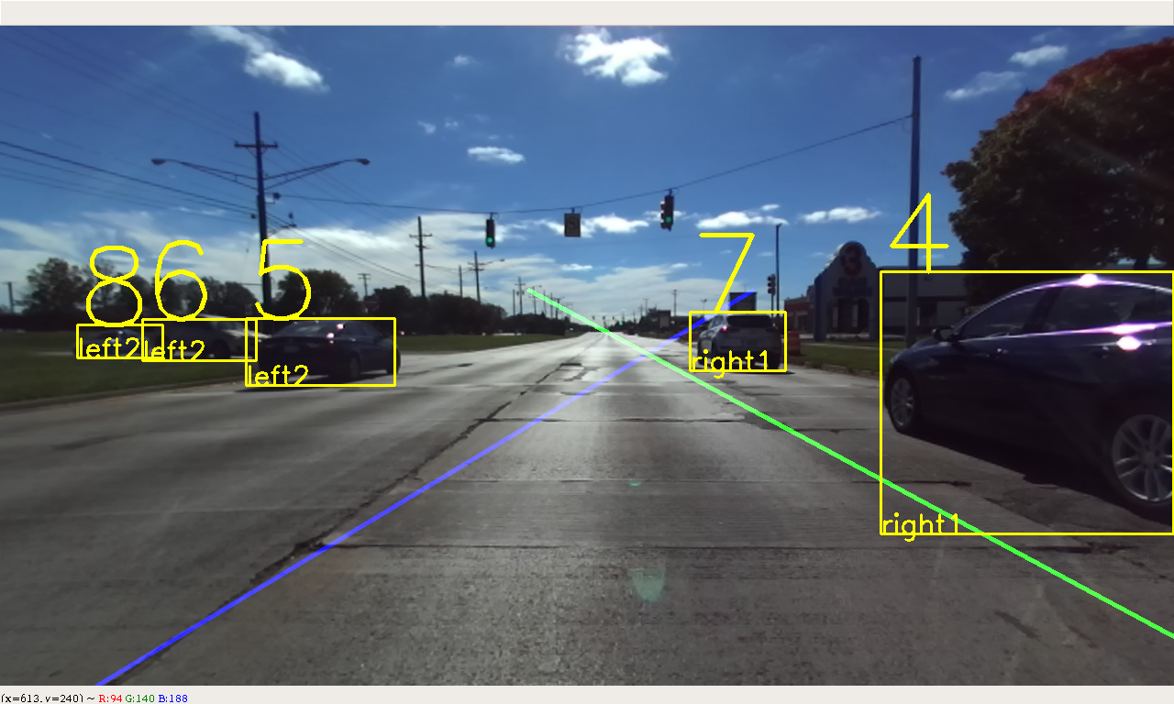
Perception Generation
Vehicle detection
YOLO: pre-trained deep neural network
Lane level position determination
Distance between bounding box corner and lane marker
Notes:
Now let’s discuss the system in detail,
The first component is perception generation
On the right there is a typical front view image of a vehicle driving on the road.
We first conduct vehicle detection using a pre-trained deep neural network called YOLO, which highlight each detected vehicle using a bounding box. We further assign an ID number to each bounding box.
Then we determine each vehicle’s lane position by referring to the distance between the bounding box corner and the lane marker.(Show animation)
Here we choose the threshold to be 1/3 of the bounding box width. If the distance is smaller than this threshold, then the vehicle is in the first left/right lane, if it’s larger than this threshold then the vehicle is in the second left/right lane or further.

Slide 8
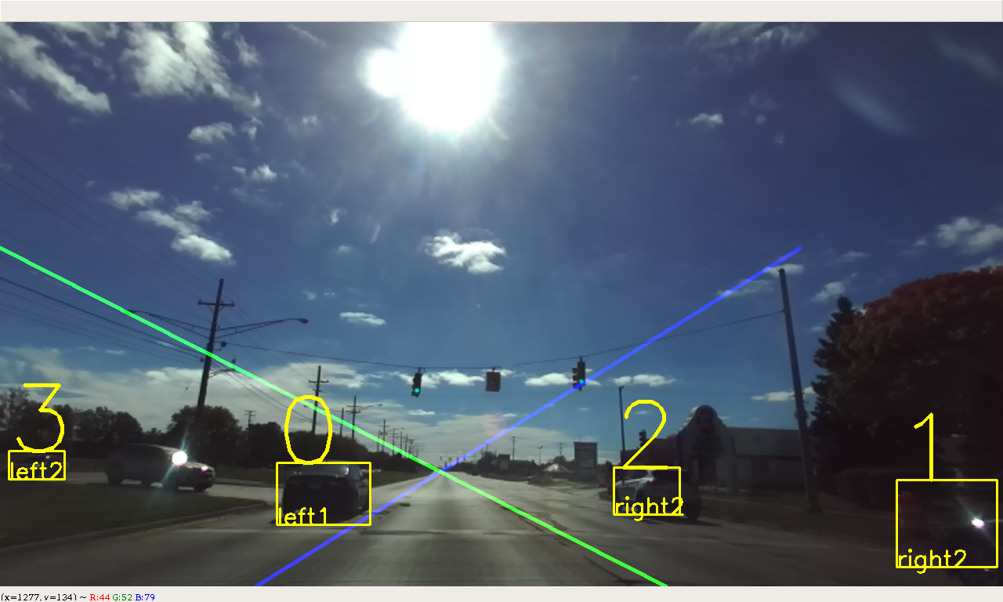
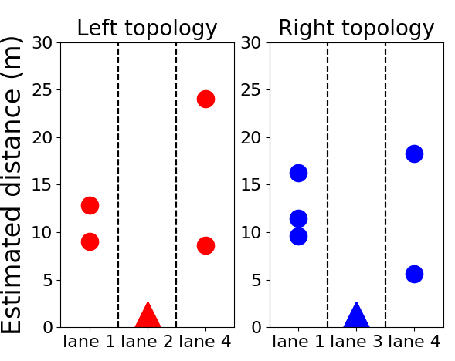
Perception Generation cont.
Usally we need depth camera or structure from motion to…..
Here we can estimate the depth with the detectged vehicle’s lane position (On the straight road,,,assuming the lane width and the known lane level position, we can )
What we have:
Distance estimation
Left view
Right view
$$L$$
Pixel coordinates
3D world coordinates
Estimated distance
$$X≈L$$
Camera matrix
$$X$$
$x=f_{x} ⋅X+c_{x}⋅Z$, $w=Z$
$$x_{p}=f_{x} ⋅\frac{X}{Z}+c_{x}$$
d?
$$D=Z=f_{x} ⋅\frac{n×L}{{|x}_{p}−c_{x}|}$$
$$x_{p}$$
Notes:
Besides detecting vehicles for each view, we also estimated each vehicle’s longitudinal distance.
Assume the world coordinate system is coincident with camera’s coordinate system. Using camera projection geometry,
We need the lateral coordinates in pixel as well as lateral position in the real world coordinate to estimate a vehicle’s depth.
(Show animation), as the diagram shows, we assume the observing vehicle and the detected vehicle is driving on the highway in a lane-keeping fashion,
The lateral distance between them is approximately the lane width, as each vehicle intends to drive in the center of the lane.
Using this approximation, we able to estimate each detected vehicle’s depth.(Show formula)
Using each vehicle’s depth, and lane level position, we able to construct individual topology for each observing vehicle, (Show animation)

Slide 9
Topology Fusion
Vehicles abstracted as nodes
Edge scores describes dissimilarity
Less score = more similar
Each association decision is a matching
The most likely association decision is the matching that has the minimum sum of scores
2
s1
s2
4
s3
1
s4
s5
3
s6
0
Notes:
After individual topologies are constructed, we transfer the extracted features and merge two views in the Topology fusion component.
We proposed a bipartite merging algorithm to do the job
as the bipartite graph shows, we are trying to find associations between vehicles from two views.
each node represents a detected vehicle, and different color denotes different views.
The edge scores describes two vehicles dissimilarity, the less the score is, the more similar they are.
This fully connected bipartite graph contains all the potential association pairs for all the detected vehicles in two views. We prune this bipartite graph such that it becomes an optimal matching that has minimum sum of scores (Show animation)

Slide 10
What are the edge scores?
Suppose car A detects vehicle u, car B detects vehicle v
Scores to describe {u, v}’s dissimilarity
Spatial score: $s_{dist} = \left|\left|Depth_{u}−Depth_{v}\right|−D_{AB} \right|$
$D_{AB}$: the longitudinal distance between Car A and Car B
Color score: $s_{color} =\left\|\frac{H_{u}}{\left\|H_{u}\right\|} −\frac{H_{v}}{\left\|H_{v}\right\|}\right\|$
$H_{u}$: color histogram (24x1)
Keypoint score: $s_{desc}=\frac{Σ_{i}^{N}\left\|desc{\left[i\right]}_{u} −desc{\left[i\right]}_{v}\right\|}{N}$
$desc\left[i\right]$: the ith SIFT descriptor (128x1) or SURF descriptor (64x1)
Notes:
The next question is what are those edge scores
The edge scores are computed using different features of the detected vehicles
Spatial score: we convert two vehicles depth to the same coordinate system and compute their differences, the smaller the score is, the more likely the two cars are at the same place.
Color score: we extract color histogram for each vehicle using 24 bins, and compute the Euclidian distance between two normalized color histogram vector.
Keypoints: we compute the average difference for all the keypoint matches from two detected vehicles.
Here SIFT and SURF are two methods that calculate distinctive features from images that allow reliable matching between different views of the same object or scene.
These descriptors are robust to scale variances, rotations, and illumination changes.
In the bipartite merging algorithm, we use different combinations of these scores.

Slide 11
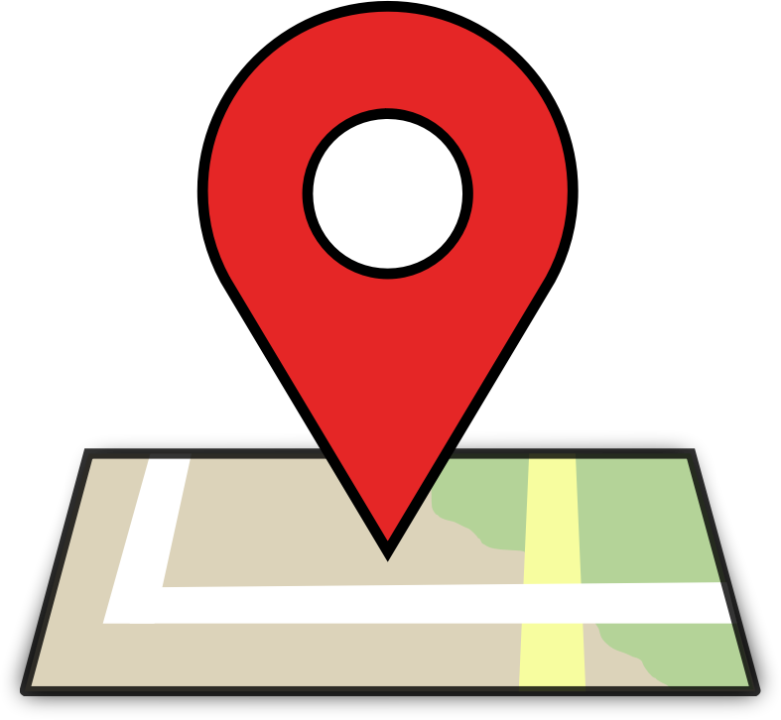
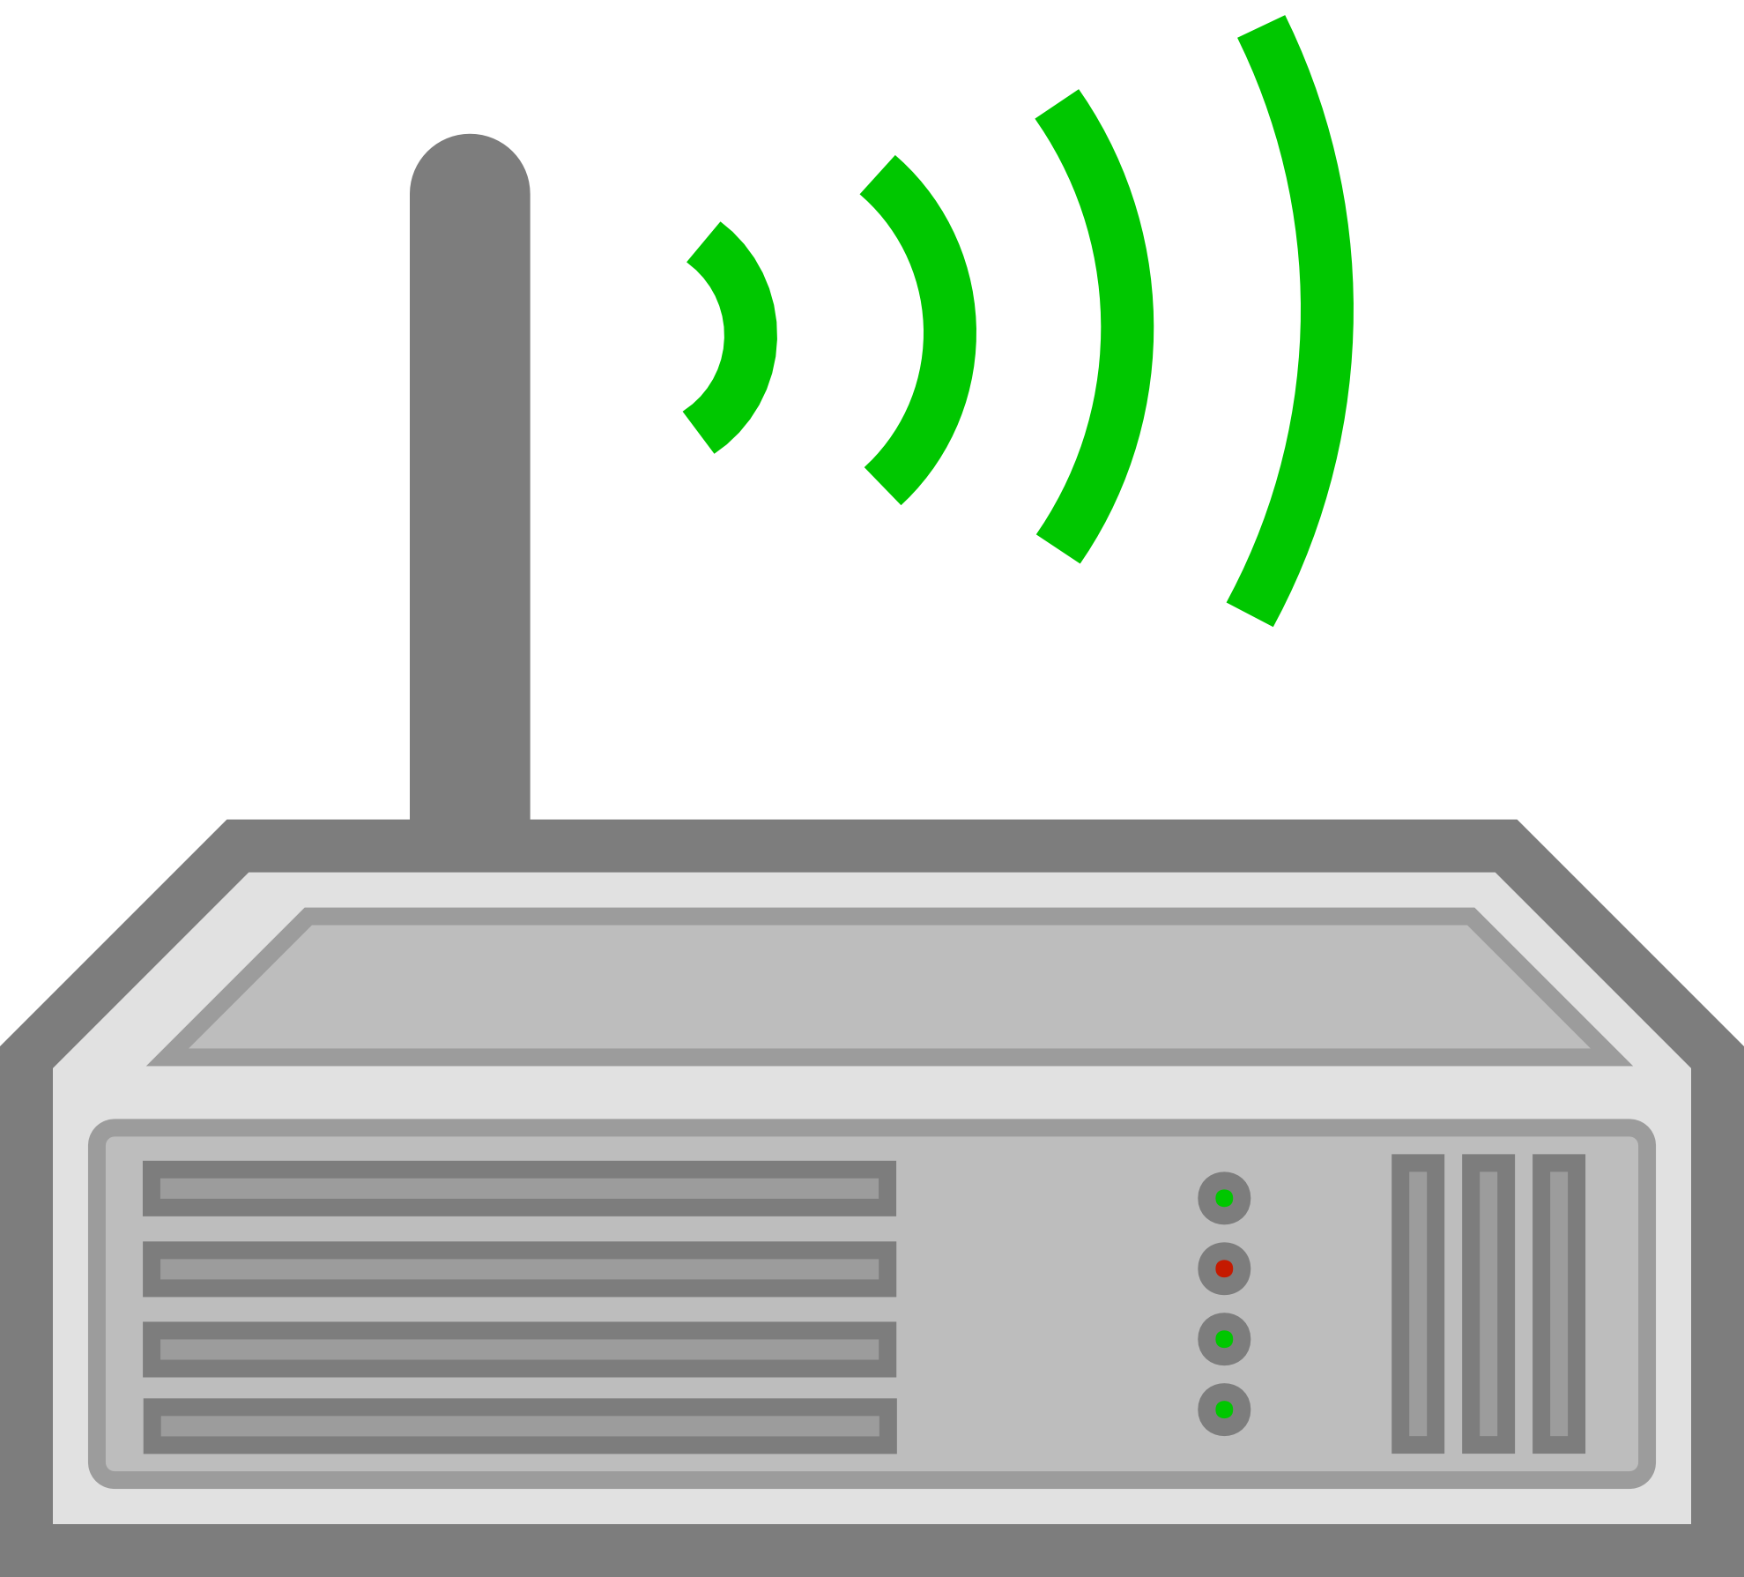
Experiment setups
Assumptions:
Side by side driving
Few lane changes
Straight road
Data collection
NTP time synchronization
40-50mph speed
~2 hour video, ~2800 pairs of valid frames
~3.3G information exchanged
Notes:
Next we discuss how features are transmitted in the experiments.
The diagram on the right depicts our experiment setups:
Two observing vehicles driving side by side at the normal speed on the high way, each equipped with GPS module, a camera, and a wireless router that runs on 802.11ac and The camera is recording each vehicle’s front view, while the information is being shared between two routers.
For time synchronization we use NTP,
In total we collect 2 hour video with around 2800 pairs of valid frames. There is Overall around 3.3G information exchanged.

Slide 12
Transmission Policy
UDP
Two types of packet format
Light-weighted but important
Depth: 32 bytes, color histogram: 24 * 32 bytes
With repetition coding (x2)
Heavy-weighted and less important
128 * 32 = 4096 bytes per keypoint.
No repetition coding
Timestamp | Video frame ID | Vehicle ID | GPS | Estimated depth | Color histogram
Timestamp | Video frame ID | Vehicle ID | GPS | 1 SIFT / 2 SURF descriptors | Batch ID
Notes:
For Transmission policy, we choose UDP since it doesn’t guarantee the transmission as in TCP. In our application each vehicle need to send the most updated messages to its peers, so the back and forth communications in TCP might delay the current message, thus not suitable in our application.
UDP buffer limit: 65535 bit ( or 64 Kilobytes)
Two types of packet format:
Depth is just a floating point number, color histogram is a 24x1 floating point vector
1 light weight but important, as they are essential for vehicle verification between two views, so we send them twice during each transmission
For each detected vehicle patch in a video frame, we split the whole SIFT/SURF descriptors (which is Nx128 for SIFT and Nx64 for SURF) into batches, each batch contains 1 SIFT or 2 SURF keypoint descriptors. We transmit these batches along with the batch ID
2 heavy weight and less important, so we only transmit once.

Slide 13
Metrics to evaluate FusionEye
Merging accuracy
Precision
Recall
F-score
Transmission-wise
Average transmitted data size: the average transmitted data size transmitted per video frame
Latency: the duration from the time a video frame is grabbed till all necessary information is received
Packet error rate: the ratio of the number of dropped packets to the total number of transmitted packets of a certain type of feature combination
Notes:
Before we show the merging results, it’s necessary to first define some metrics
Merging accuracy:
What is true positive: two detected vehicle should be merged is merged as one during association.
We compute tpr, fpr, tnr and fnr using predictions provided by pruned bipartite graph and ground truth that we manually labeled offline. to compute Precision, recall and F-scores
(Precision = TP/TP+FP), (Recall = TP/TP+FN), F1 Score = 2*(Recall * Precision) / (Recall + Precision)
Some transmission metrics
Average transmitted datasize: the average transmitted data size transmitted per video frame, which contains multiple bounding boxes.
Latency: the duration from the time a video frame is grabbed by the camera till all necessary information is received by the receiver side so that the merging process can start.
Packet error rate: the ratio of the number of dropped packets to the total number of transmitted packets of a certain type of feature combination

Slide 14
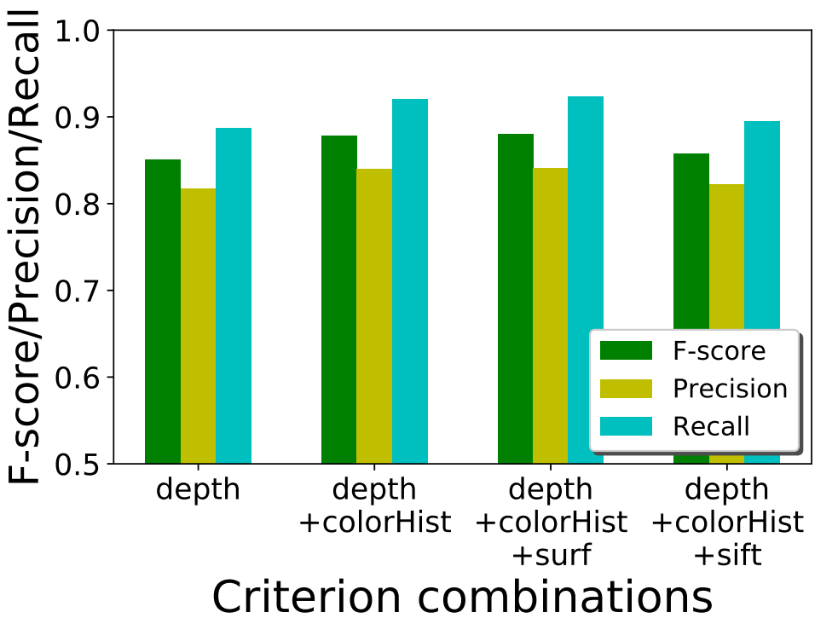
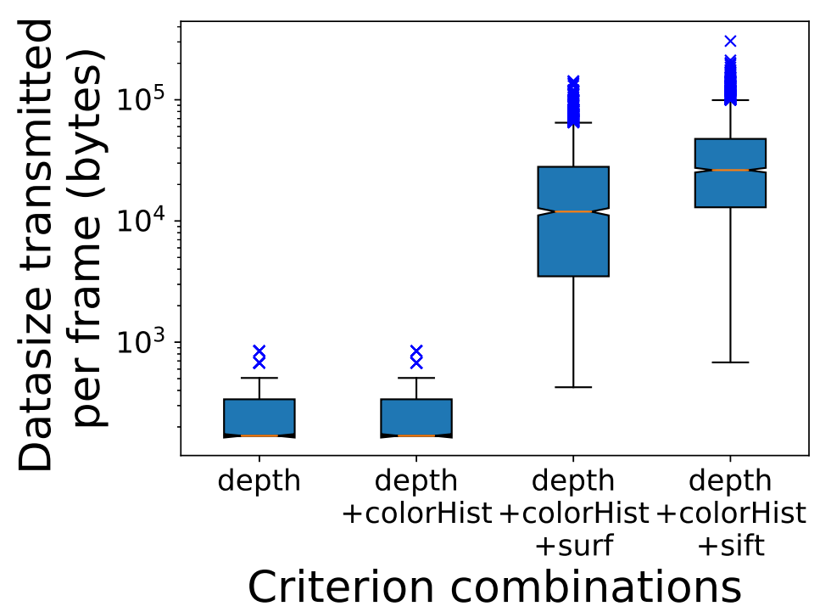
Merging accuracy & Bandwidth
Be precise about the numbers
Notes:
Now its time to show the accuracy and bandwidth trade offs
Let’s first focus on accuracy first
The figure on the left presents precision, recall, and F-scores for 4 merging policies in which different combinations of features that are used to compute the edge scores in the bipartite graph.
The best accuracy comes with depth+colorHist+surf, which is 0.88 in terms of f-score
We notice that in general the performance of the merging algorithm improves as we incorporate more fine-grained descriptors to compute edge scores.
Naturally, the merging accuracy improves as the description of a vehicle becomes more comprehensive and robust as more information is taken into account. But the improvement in terms of accuracy is only marginal.
(also notice, the last combination, (depth+chist+sift) gives us slightly worse performance.)
We are also interested how much information is shared to achieve such accuracy. The figure on the right presents the average transmitted data size for a video frame.
We can see that the first two combinations uses much less data size. (around hundreds of bytes) While the SURF and SIFT features consumes significantly more bandwidth(average of more than 10k bytes) during transmission.

Slide 15
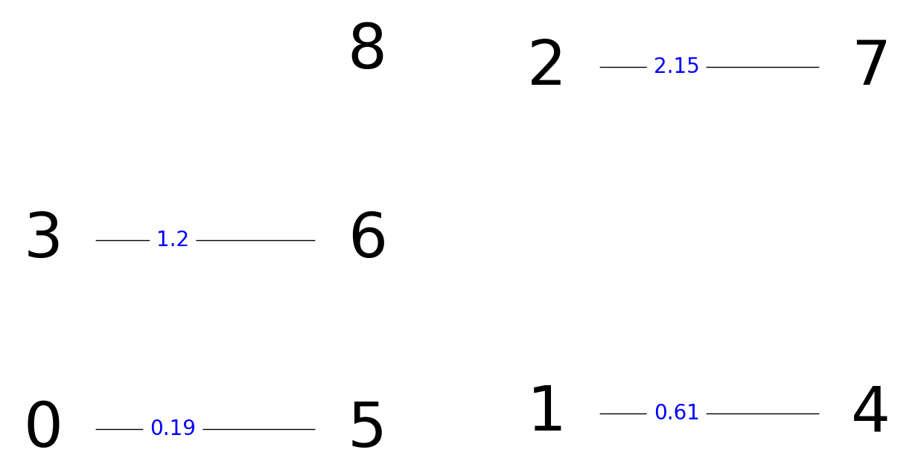
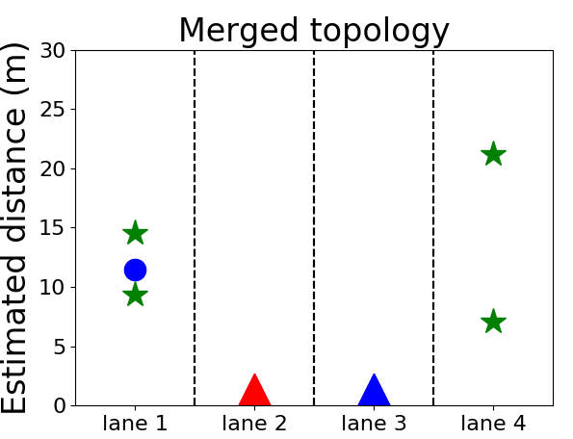
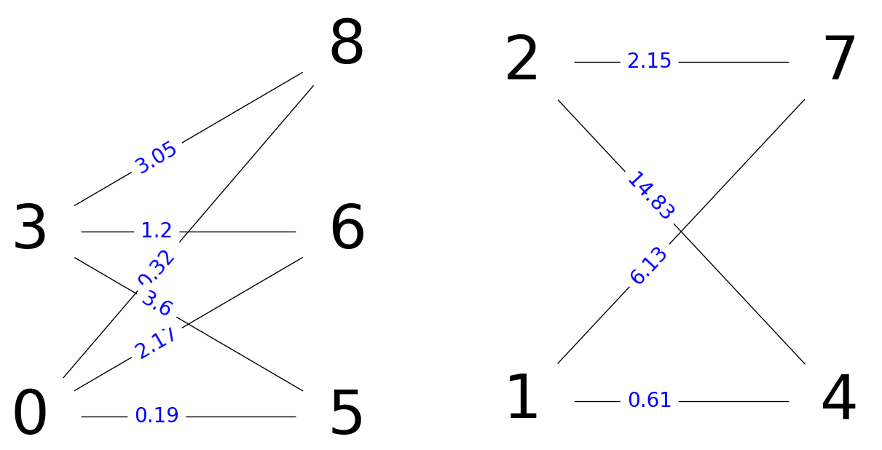
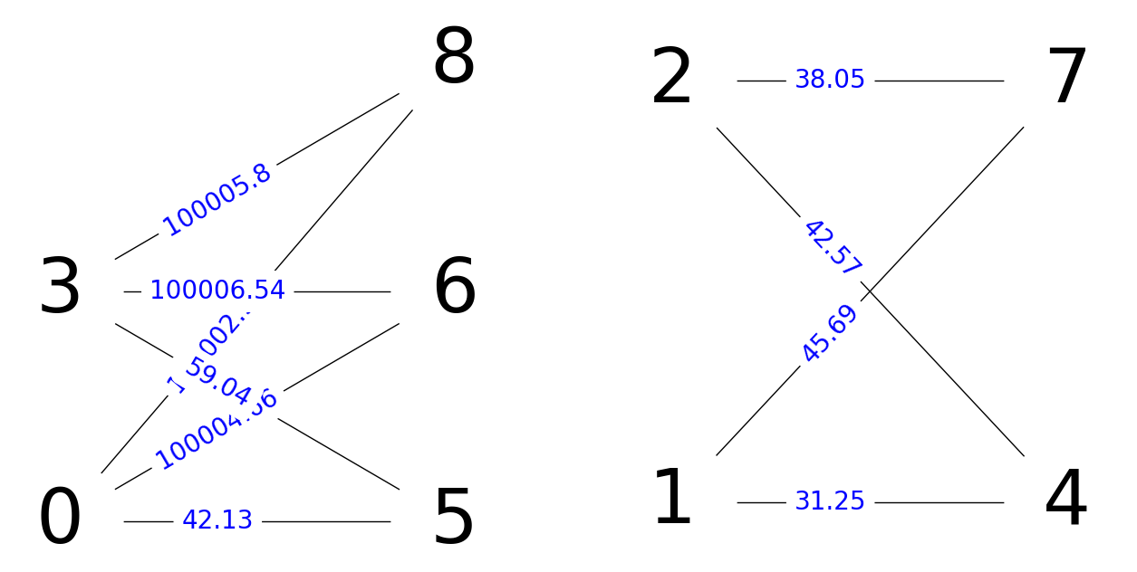
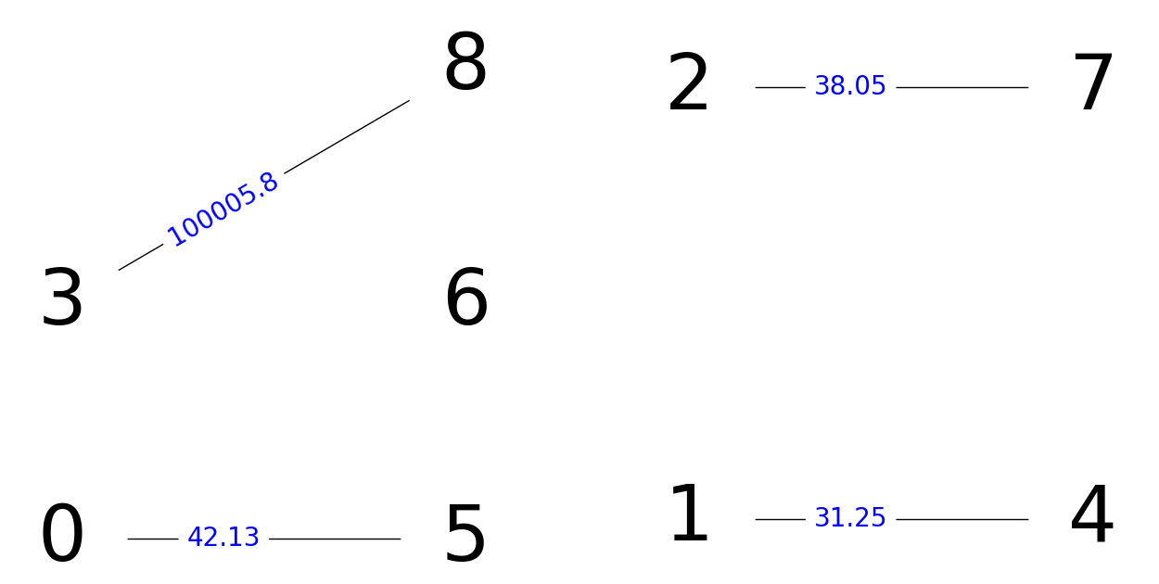
Merging results
Merge using depth, color histogram, and SURF
Merge using depth only
Notes:
Here we show a merging example. Here are the two front views from two observing vehicle, and their individual topology
First we merge the two views using depth socre only, (show animation)
We found that 3-6 is falsely matched
Then let’s use depth, color histogram and SURF score(Show anumation)
This time we got correctly associate every pair of vehicles.
Using the correct association, we are able to construct the merged topology as shown here(show animation)

Slide 16
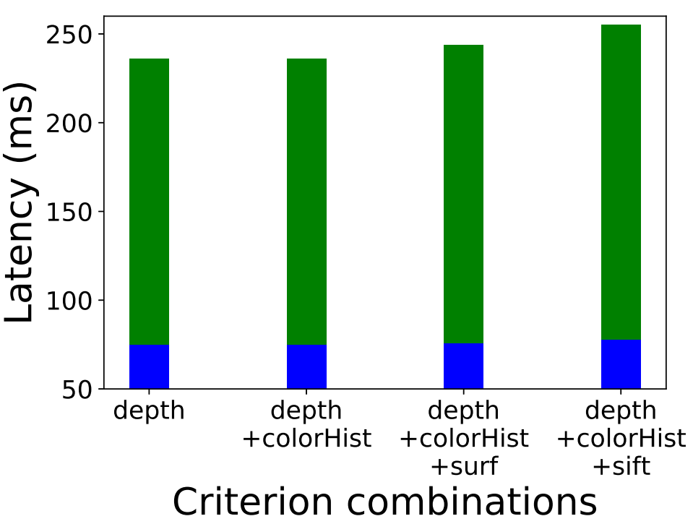
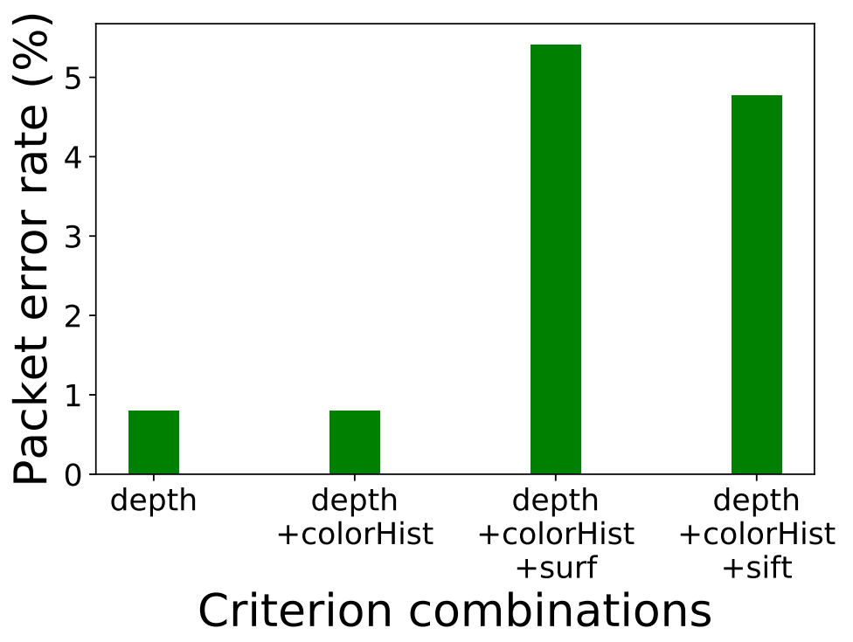
Transmission Analysis
Notes:
Here we also care about other statistics such as latency and packet error rate
Recall latency: the duration from the time a video frame is grabbed by the camera till all necessary information is received by the receiver side so that the merging process can start.
We also observe that the more comprehensive the criterion is, the higher the latency becomes.
The baseline latency is shown in blue for each bar, which consists of image processing time including vehicle detection using YOLO, estimating depth value according to the bounding box coordinates as well as computing SIFT/SURF descriptors for that bounding box patch.
Next is packet error rate: the ratio of the number of dropped packets to the total number of transmitted packets of a certain type of feature combination
We observe that since surf and sift packets are more bandwidth consuming, those packets are more easily to be dropped during the transmission.
Recall that SIFT/SURF features only offer slightly better accuracy, the transmission analysis here gives us an insight that maybe SURF/SIFT features does not provide a big win in terms of accuracy-bandwidth trade off.

Slide 17
Wrap-up
Limitation
More robust features to explore
More complex traffic environment and other traffic participants
Conclusion
Bipartite merging can be used with different features
Merging accuracy reaches the accuracy of 88%
Richer descriptors offer only marginal(~2%) accuracy improvements
More compact descriptors appear preferable from a bandwidth-accuracy trade-off perspective
Notes:
Now time for wrap-up.
There are several limitation of our work.
1. The bipartite algorithm may still give us false positives, especially when there are no overlaps between two views, (the algorithm will always try to find a matching) Thus, an extension of our work is need to further explore more features as well as further prune the bipartite graph to filter out those false positives
2. Also, more complex experiment environment with different traffic density and other traffic participants (not limited to vehicles) are worth exploring
To conclude our work.
Our system and bipartite merging algorithm adapts well to different combinations of features and provide an opportunity to explore accuracy and bandwidth tradeoff for connected vehicles.
Richer descriptors only offer marginal accuracy improvements
More compact descriptors such as depth and color histogram turn out to be preferable from a bandwidth-accuracy trade-off perspective.

Slide 18
Thank You!
Notes:
Questions?

